Slide 1
Introduction to NHibernate
Mike Hadlow
mikehadlow.blogspot.com
mikehadlow@gmail.com
Twitter: mikehadlow

Slide 2
What’s in the talk?
A brief history of data access in .NET
Why ORMs rule
Introduce Nhibernate
Demo
How to use Nhibernate in a web application
Resources

Slide 3
A brief history of data access in .NET
Classic VB had DAO, RDO, ADO and the recordset
ADO.NET introduced the DataSet
Move to more OO model, hand written DAL
Code generation (Code Smith etc)
Object Relation Mapping (ORM) tools

Slide 4
Why ORMs rule
Productivity
Productivity
Productivity
Did I say productivity?

Slide 5
NHibernate
Port of Hibernate
Natural OO programming model
Supports Persistence Ignorance
Rich mapping
Powerful query options
Open source

Slide 6
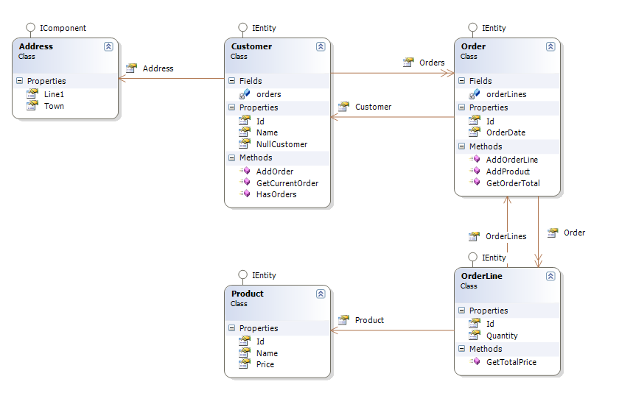
Demo

Slide 7
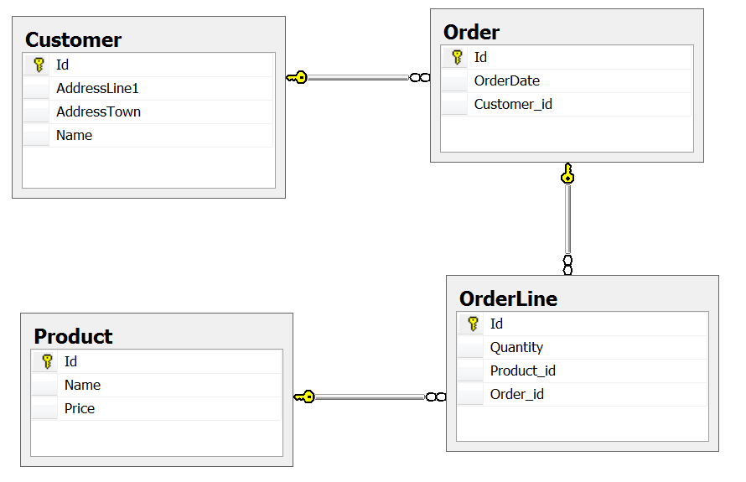
Physical Data Model

Slide 8
How to use Nhibernate in a Web Application
Consider a framework (S#arp)
Create a session factory on application start
Create a session per request
Always use explicit transactions

Slide 9

Resources
Nhibernate: https://www.hibernate.org/343.html
Fluent Nhibernate: http://fluentnhibernate.org/
NH Profiler: http://nhprof.com/
S#arp Architecture:
http://code.google.com/p/sharp-architecture/
Nhibernate in Action

